Slide 1
Graph Colouring
Presented by
Laxminarasimha Soma

Slide 2
Early History of Graph colouring
Graph coloring originated from a natural problem in cartography: given some map, how can we color each area to distinguish it, without two neighboring areas having the same colors.
This was first observed by Francis Guthrie. He had noticed that he could color the counties of England using four different colors.
Later years Fredrick, who was a mathematics student, informed his professor Augustus De Morgan, which introduced graph coloring to academic circles.
This resulted in the four-color theorem: any planar graph can be colored using four colors.

Slide 3
Major developments in later years
While the conjecture was easy to encounter in practice but it demonstrated to be difficult to be proven. The First supposed proof in 1890, by Alfred Bray Kempe stood for 10 years until was disproved by Percy John Heawood.
It took until 1976 for the theorem to finally be proven. This proof used a thousand cases, for which it required computer assistance, no human was able to verify the correctness of the proof.
This four-color theorem sparked the first major research on graph coloring. From this, it was logical step to extend planar graph coloring to coloring any given graph, determining the minimum number of colors such that a proper coloring of some graph exists with that number of colors.

Slide 4
Introduction
In Graph theory graph colouring is a methodic assignment of labels traditionally called “colours” to elements of a graph.
The assignment is subject to certain constraints, such as that no two adjacent nodes in a graph has same colour.
Graph colouring in is a special case of colouring the vertices of a graph is called as vertex colouring.
Colouring the edges is called as Edge colouring.

Slide 5
Vertex colouring
Colouring the vertices of graph such that no two adjacent colours have same colour
Vertex colouring Is often used to introduce graph colouring problems, since other colouring problems can be transformed into a vertex colouring instance.
The minimum number of colours we require to colour the vertices of a graph is known as chromatic number. Generally this number is always greater then one.
The concept of vertex colouring is used in many areas of computer science and mathematics. Additionally we can model complex real-life problems to vertex colouring problem.
Finding the chromatic number is difficult because it belongs to NP- complete class.

Slide 6
Edge colouring
Edge colouring is colouring the edges such that no node/vertex is connected to the same coloured edges
An edge with colors k is known as k-edge-colored graph.
It is also same like the vertex coloring but colored the egdes instead of vertices.
The minimum number of colors required to do the edge coloring is known as chromatic number.

Slide 7
Example
2
3
4
1
5
8
7
6

Slide 8
Example
2
3
4
1
5
8
7
6

Slide 9
Example
2
3
4
1
5
8
7
6

Slide 10
Example
2
3
4
1
5
8
7
6

Slide 11
Example
2
3
4
1
5
8
7
6

Slide 12
Example
2
3
4
1
5
8
7
6

Slide 13
Example
2
3
4
1
5
8
7
6

Slide 14
Example
2
3
4
1
5
8
7
6

Slide 15
Example
2
3
4
1
5
8
7
6

Slide 16
Applications of coloring
Graph coloring can be used in
Scheduling Problem
Network routing problem
Compilers

Slide 17
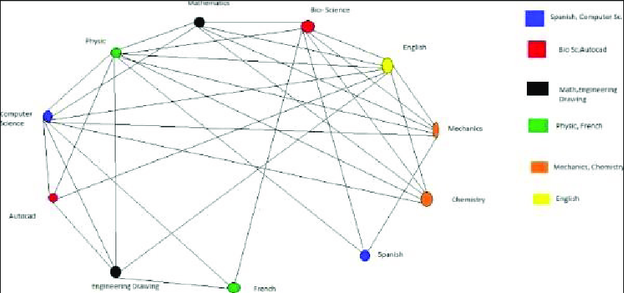
Scheduling problem
In scheduling problem
We must assign the resources to the available tasks and avoid conflicts.
To solve this problem, we can represent each task as a vertex and each resource as a color
We can determine the chromatic number from this graph.
The chromatic number represents the minimum number of resource to complete all tasks without conflicts.

Slide 18
Network routing problem
In routing
Data packets must be routed through a network of nodes without conflicts.
We can use vertex coloring to model this problem, with each node representing a vertex and each path representing a colour in the graph
The chromatic number denotes the least possible number of paths required to route all packets without conflicts.

Slide 19
In compilers
In compilers
Variable in a programs must be assigned to registers in a computer’s processor.
We can utilize vertex coloring and chromatic number concepts
In order to provide the least possible number od registers needed to execute program

Slide 20
Sample questions
What is vertex coloring of a graph? a) A condition where any two vertices having a common edge should not have same color b) A condition where any two vertices having a common edge should always have same color c) A condition where all vertices should have a different color d) A condition where all vertices should have same color
Minimum number of unique colors required for vertex coloring of a graph is called? a) vertex matching b) chromatic index c) chromatic number d) color number

Slide 21
Sample Questions
How many unique colors will be required for proper vertex coloring of an empty graph having n vertices? a) 0 b) 1 c) 2 d) n
How many unique colors will be required for proper vertex coloring of a bipartite graph having n vertices? a) 0 b) 1 c) 2 d) n

Slide 22
Video Link for the presentation
https://youtu.be/GX-2b_I9Yek

